Slide 1
Submitted by Mr. Nagane Abhijit Shantaram Mr. Mutkule AbhijeetKashinath Mr. Kolhe Pranjal Milind Mr. Pathak Vinayak Vijay
" HOME AUTOMATION USING ANDROID PHONE OVER BLUETOOTH "

Slide 2
INDEX
INTRODUCTION TO THE PROJECT
BLOCK DIAGRAM
HARDWARE REQUIRED
PROCESS OF MAKING RELAY CIRCUIT
SOFTWARE USED
ADVANTAGES
DISADVANTAGES
REFERENCES

Slide 3
INTRODUCTION
To develop a Bluetooth based home automation system with Arduino-UNO Board and an Android application.
Remote controlled home automation system provides a simpler solution with Android application technology.
Remote operation is achieved by any smart phone/Tablet etc., with Android OS, upon a GUI(Graphical User Interface) based touch screen operation.

Slide 4
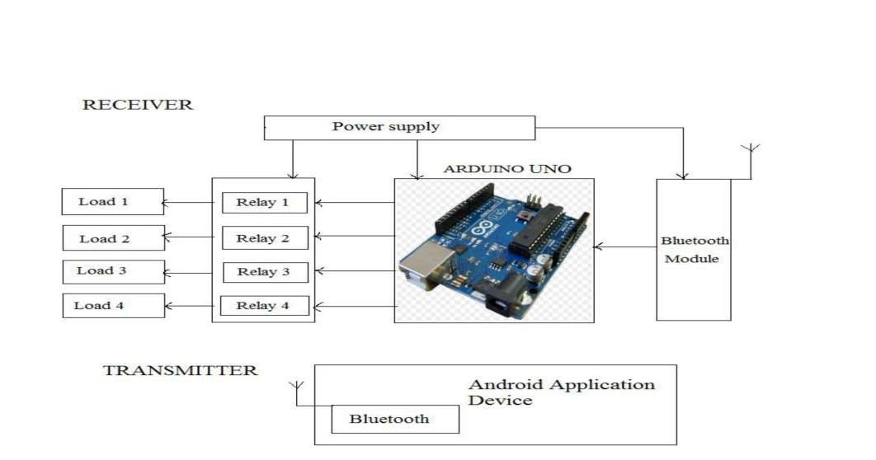
BLOCK DIAGRAM

Slide 5
HARDWARE REQUIREMENTS
Arduino UNO
Bluetooth Module -HC-05
12V Relay
Transistors BC 548, Resistors
Power Supply 230v,50Hz.
Switch board

Slide 6
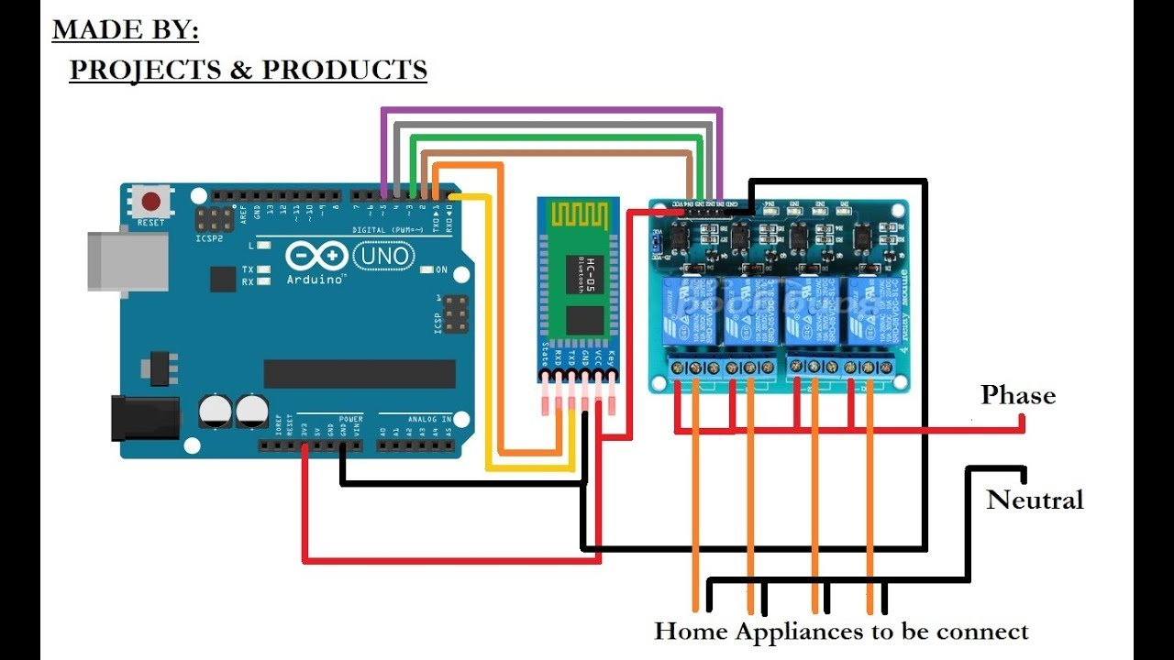

Slide 7
ARDUINO UNO
The Arduino Uno is a microcontroller board based on the ATmega328P.
It has 14 digital input/output pins (of which 6 can be used as PWM outputs), 6 analog inputs, a 16 MHz quartz
crystal, a USB connection, a power jack, an ICSP header and a reset button.
Simply connect it to a Computer with a USB cable or power it with a AC-to-DC adapter or battery to get started.

Slide 8
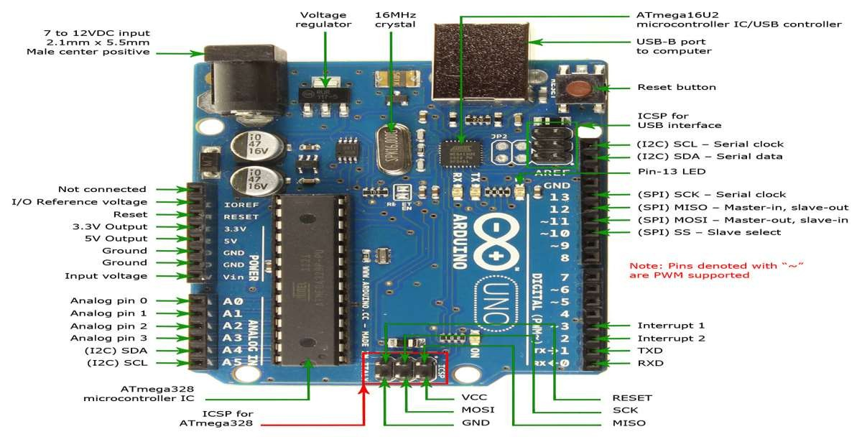
ARDUINO BOARD

Slide 9
ARDUINO UNO SPECIFICATIONS
MICROCONTROLLER
OPERATING VOLTAGE
DIGITAL I/O PINS
PWM DIGITAL I/O PINS
ANALOG INPUT PINS
FLASH MEMORY
CLOCK SPEED
: ATMEGA 328P
: 5V
: 14
: 6
: 6
: 32KB
: 16MHZ

Slide 10

BLUETOOTH MODULE
For the communication between mobile phone and microcontroller Bluetooth module (HC-05) is used.
HC-05 is low power 1.8V operation and is easy to use with Bluetooth SPP (serial port protocol).

Slide 11
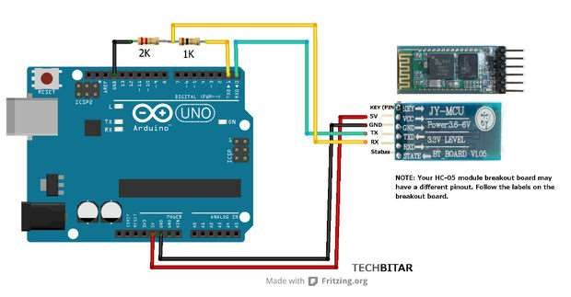
BLUETOOTH MODULE PIN LAYOUT

Slide 12
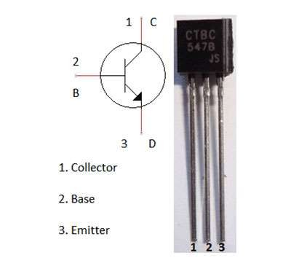
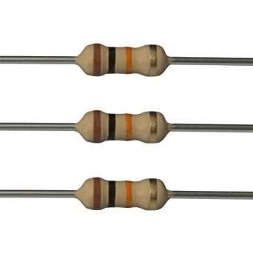
Resistors
TRANSISTOR BC 547

Slide 13
RELAY
Relay is basically an electromagnetic switch which can be turn ON and OFF by applying the voltage across its contacts.
In this project we used a 12V 5 pin relay.

Slide 14
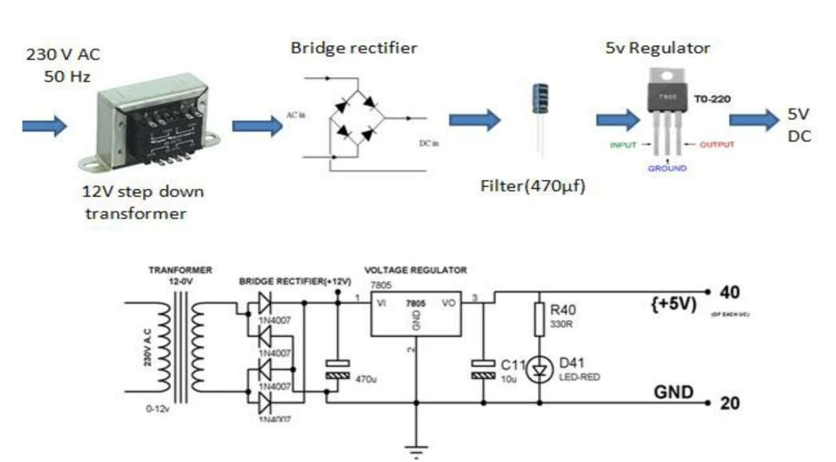
POWER SUPPLY

Slide 15
ADVANTAGES
It is a robust and easy to use system.
It will save your energy and money.
Provides Security.
Convenience and comfort.
Can be used by physically challenged and disabled people.
Complexity is less as only a single mobile is used multiple devices.
Smart home technology.

Slide 16
DISADVANTAGE
Only works for limited range or short distance with in 5-10m surroundings.
No feedback path.
Number of appliances which can be controlled through this circuit are limited.
Circuit complexity increases as number of devices increase.

Slide 17
FUTURE WORK
This setup can further be developed into IOT project by using Ethernet arduino and a wifi
module.
So , it can be controlled from anywhere around the globe having feedback from the devices to further improve the energy savings.

Slide 18
THANK YOU FOR YOUR ATTENTION

